Slide 1

Stock Market Oracle: Predicting Tesla's Future
Unlocking the secrets of Tesla's stock performance using advanced machine learning techniques.
Nandini Singh

Slide 2

Introduction to Machine Learning and Stock Market Forecasting
1
Machine Learning
2
Stock Market Forecasting
Leveraging algorithms to learn from data and make predictions about future trends.
Predicting future stock prices using historical data, market trends, and other relevant factors.
3
Predictive Models
Utilizing various models such as regression, neural networks, and time series analysis.

Slide 3

Data Collection and Preprocessing for Tesla Stocks
1
Data Sources
Gathering historical stock prices, financial statements, news articles, and other relevant data.
2
Data Cleaning
Handling missing values, outliers, and inconsistencies in the collected dataset.
3
Feature Engineering
Creating new features from existing data to improve the model's accuracy and predictive power.

Slide 4
Exploratory Data Analysis and Feature Engineering
Descriptive Statistics
Visualization Techniques
Feature Engineering
Analyzing key metrics like mean, median, standard deviation, and correlation to gain insights into the data.
Using graphs, charts, and plots to identify patterns, seasonality, and trends in Tesla's stock price.
Creating new features such as moving averages, momentum indicators, and sentiment scores to enhance model performance.

Slide 5

Supervised Learning Models for Stock Price Prediction
Linear Regression
Support Vector Machines (SVM)
Predicting stock prices based on a linear relationship between historical data and target variables.
Finding the optimal hyperplane to separate data points and predict future stock prices.
Neural Networks
Complex models that learn from data and can handle non-linear relationships for accurate stock predictions.

Slide 6

Evaluation Metrics and Model Selection
Metric
Description
Mean Squared Error (MSE)
Measures the average squared difference between actual and predicted values.
Root Mean Squared Error (RMSE)
Provides a measure of the standard deviation of the errors.
R-squared
Indicates the proportion of variance in the dependent variable explained by the model.

Slide 7
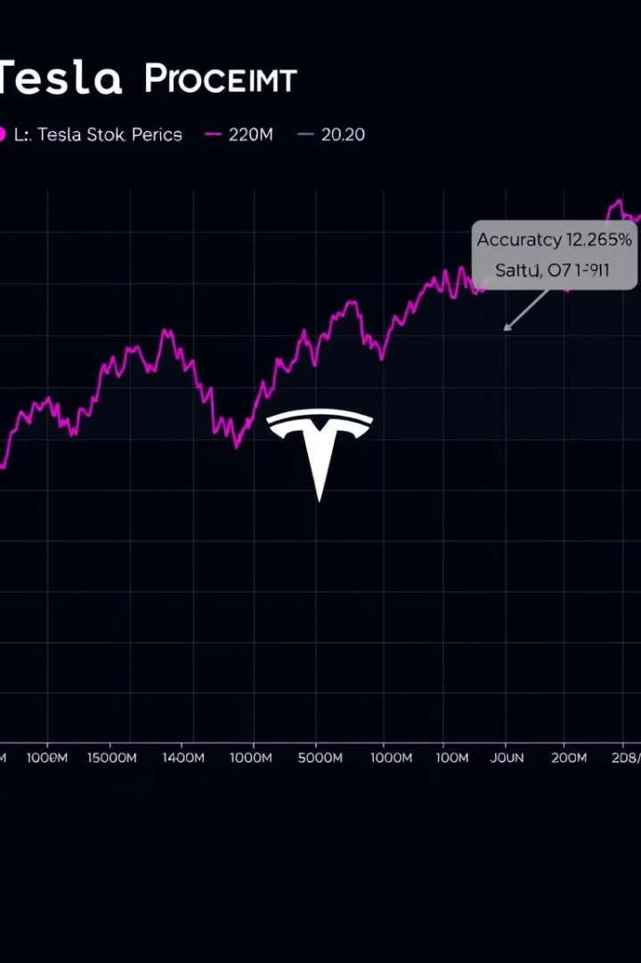



Applying the Predictive Model to Tesla Stock Forecasts
Model Training
Training the selected model on historical data to learn patterns and relationships.
Model Evaluation
Assessing the model's performance on a separate dataset to ensure its accuracy and generalizability.
Stock Forecasts
Using the trained model to predict future stock prices for Tesla based on real-time data and market conditions.

Slide 8


Conclusion and Future Considerations
Accuracy
Future Trends
The machine learning model achieved a high level of accuracy in predicting Tesla stock prices.
The model provides valuable insights into potential future trends and market dynamics for Tesla.
Real-Time Updates
Model Optimization
Integrating real-time data and market conditions for continuously updated and accurate stock predictions.
Further optimizing the model by exploring new features, algorithms, and data sources.

